Slide 1
Examining the Effects of Medicaid Expansion on Crime Rates
University of Pennsylvania, Department of Criminology
Austin Danko

Slide 2
Medicaid
Joint federal and state health insurance program
Federal law requires that states provide coverage for certain groups of people
Examples: low-income families and qualified children
Single largest source of health insurance in the U.S

Slide 3
Affordable Care Act (2010)
Created opportunity for states to expand coverage to almost all low-income Americans under age 65
Expanded coverage of children in every state
Each state given option to expand to adults with income at or below 133% of federal poverty line
Streamlined eligibility, enrollment, and renewal processes
Notes:
Also a 5% income disregard, so 133 should really be 138%

Slide 4
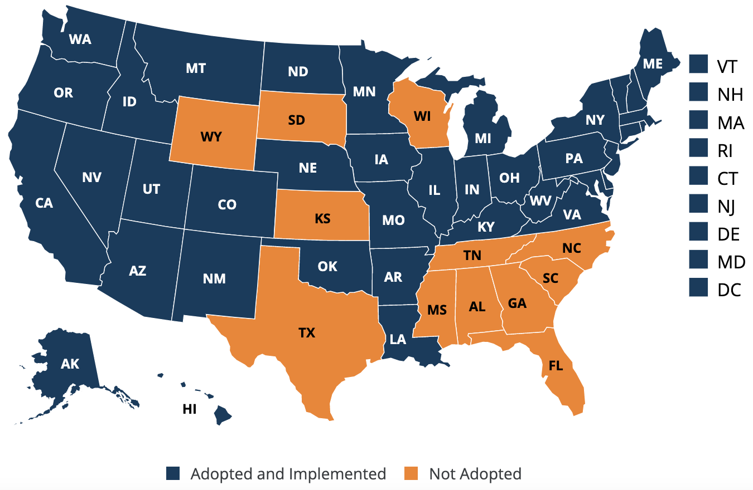
Medicaid Expansion
38 states have implemented expansion since January 2014
31 expanded at some point during years 2014-2016
12 states have not implemented expansion

Slide 5
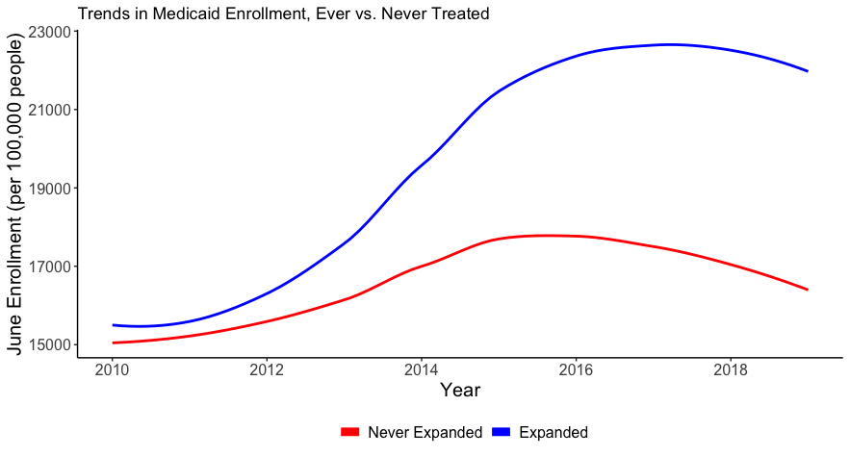
Notes:
Expansion states’ enrollment increased by about 24%

Slide 6
How could Medicaid Expansion Reduce crime?
Increasing access to mental and behavioral health services
Improving financial security
May be less of a need to resort to crime to make ends meet
Increasing opportunity cost of crime by improving quality of life outside of prison

Slide 7
Other Studies
He and Barkowski (2020): ACA Medicaid expansion was associated with reductions in crime, with stronger effects for violent crime
Vogler (2020): expansion states experienced a 5.3% reduction in annual reported violent crime rates relative to non-expansion states
Wen et al. (2017): Medicaid expansions led to reductions in robbery, aggravated assault, and larceny rates
Much of the effect likely due to increase in substance use disorder treatment rate
Notes:
H & B – state- and county-level crime rates
V – also ACA expansion
W et al. – looked at pre-ACA expansions via health insurance flexibility and accountability waivers; looked at years 2001-2008

Slide 8
Data Sources
Medicaid Enrollment Data (2010-2019)
Kaiser Family Fund
Year of Medicaid expansion and yearly enrollment counts for each state
Enrollment in June as proxy for average monthly enrollment per year
Crime Data
Demographic Data

Slide 9
Data Sources
Medicaid Enrollment Data
Crime Data (2010-2019)
Federal Bureau of Investigation’s Uniform Crime Report (UCR)
Violent crime, property crime, murder, rape, robbery, aggravated assault, burglary, larceny, and motor vehicle theft
Aggregated to year-state level
Demographic Data

Slide 10
Data Sources
Medicaid Enrollment Data
Crime Data
Demographic Data (2010-2019)
IPUMS Census data
Sex, race, education, employment, and income

Slide 11
Methods
Compare crime rates before and after Medicaid expansions were implemented
Difference in Differences
Event Study
Notes:
Notes
Cluster standard error at state level
Y_{it} is outcome variable (crime types)
$β$_{t} represents estimates for each relative year
D_{it} is dummy variable for year relative to expansion
X′_{it}γ represents all covariates (sex, race, etc) included
S_{i}$λ$ represents state fixed effects
J_{t}$τ$ represents year fixed effects

Slide 12
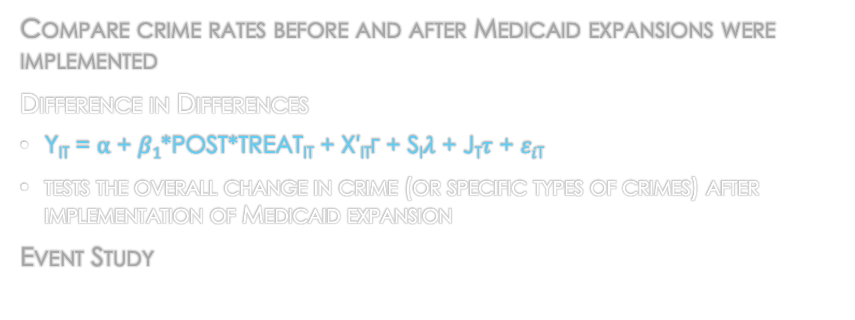
Methods
Compare crime rates before and after Medicaid expansions were implemented
Difference in Differences
Y_{it} = ⍺ + $β1$*POST*TREAT_{it} + X′_{it}γ + S_{i}$λ$ + J_{t}$τ$ + $εi$_{t}
tests the overall change in crime (or specific types of crimes) after implementation of Medicaid expansion
Event Study
Notes:
Notes
Cluster standard error at state level
Y_{it} is outcome variable (crime types)
$β$_{t} represents estimates for each relative year
D_{it} is dummy variable for year relative to expansion
X′_{it}γ represents all covariates (sex, race, etc) included
S_{i}$λ$ represents state fixed effects
J_{t}$τ$ represents year fixed effects

Slide 13
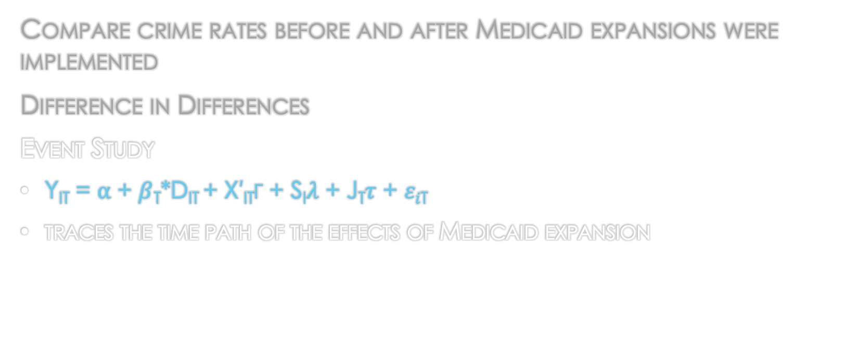
Methods
Compare crime rates before and after Medicaid expansions were implemented
Difference in Differences
Event Study
Y_{it} = ⍺ + $β$_{t}*D_{it} + X′_{it}γ + S_{i}$λ$ + J_{t}$τ$ + $εi$_{t}
traces the time path of the effects of Medicaid expansion
Notes:
Notes
Cluster standard error at state level
Y_{it} is outcome variable (crime types)
$β$_{t} represents estimates for each relative year
D_{it} is dummy variable for year relative to expansion
X′_{it}γ represents all covariates (sex, race, etc) included
S_{i}$λ$ represents state fixed effects
J_{t}$τ$ represents year fixed effects

Slide 14
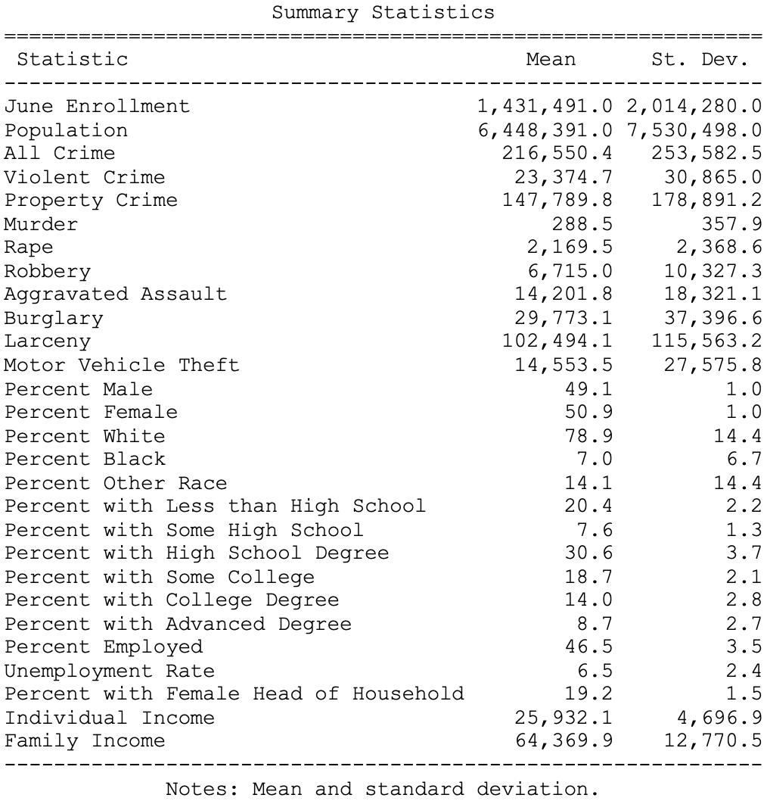
Data Summary

Slide 15
Results

Slide 16
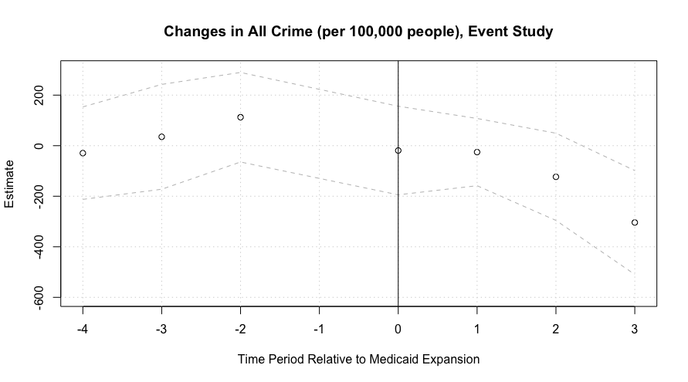
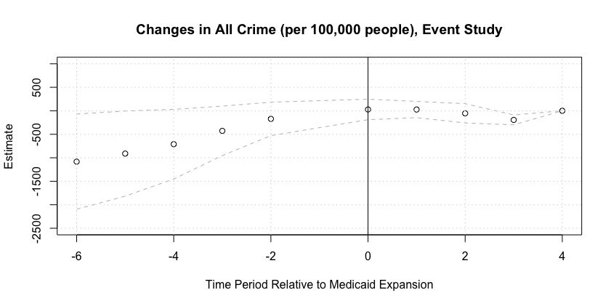

Slide 17
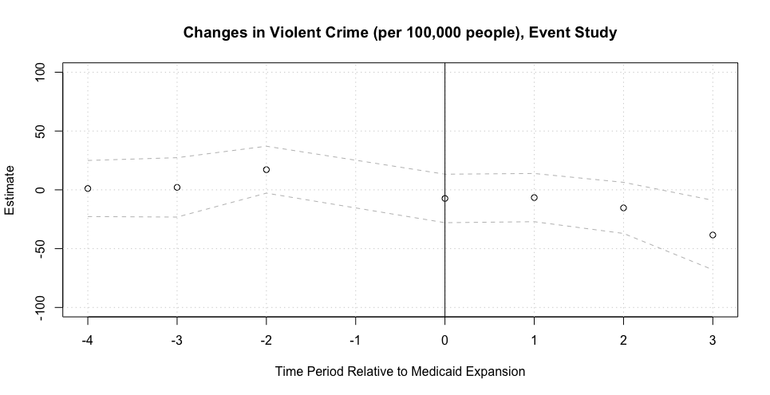

Slide 18
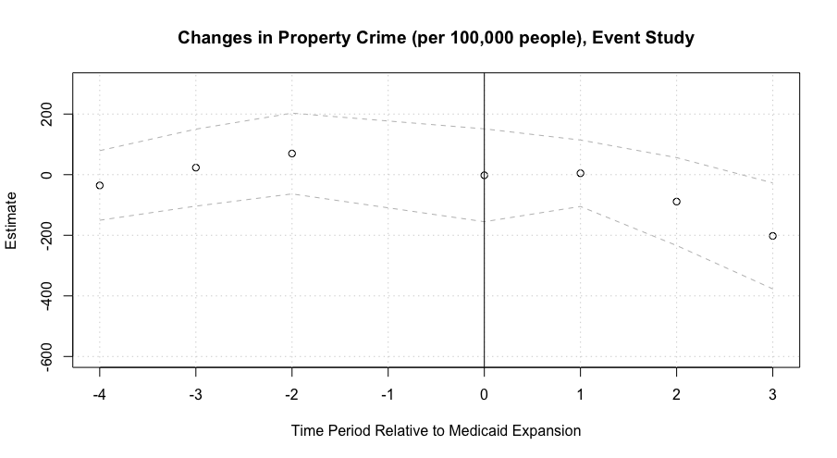

Slide 19
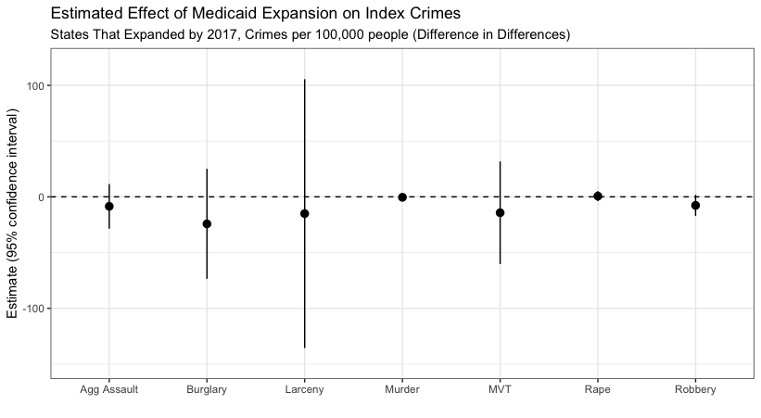

Slide 20
Findings
Crime already decreasing before Medicaid expansions implemented, but continued to decrease post-expansion
No significant effects of Medicaid expansion on crime rates

Slide 21
Limitations
Crime decreasing before expansions
Medicaid enrollment data only includes data for June of each year, so may not capture all changes in Medicaid enrollment
Used aggregate data on yearly crime in each state, which may obscure effects on specific groups of people

Slide 22
Directions for Future Research
More narrowly-focused study
Examine effects of Medicaid expansion on certain subgroups of people
Examine effects of expansion on specific states
Study effects of expansion on adults who were children when expansions were implemented

Slide 23
Examining the Effects of Medicaid Expansion on Crime Rates
University of Pennsylvania, Department of Criminology
Austin Danko
linkedin.com/in/austin-danko

